Slide 1
Exercise 14
Phylum Annelida

Slide 2
In this lab exercise, you observed animals in the phylum Annelida. Consult your lab manual for the role of each in its environment, the structures that you will need to recognize on each specimen, and their functions. You will be responsible for these on the cross section slide, on the dissected animal and on the model. As in all exercises, concentrate on those structures in bold face type and those that you were asked to label on your diagrams.

Slide 3
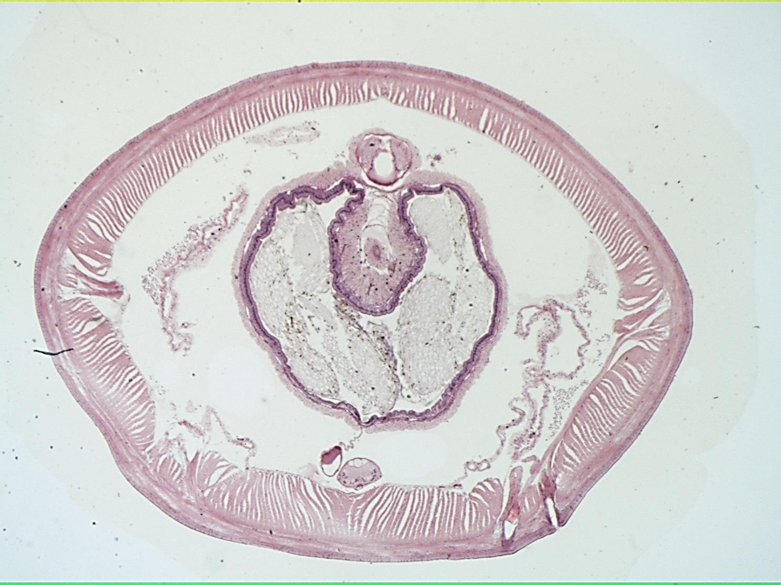
Earthworm xs

Slide 4
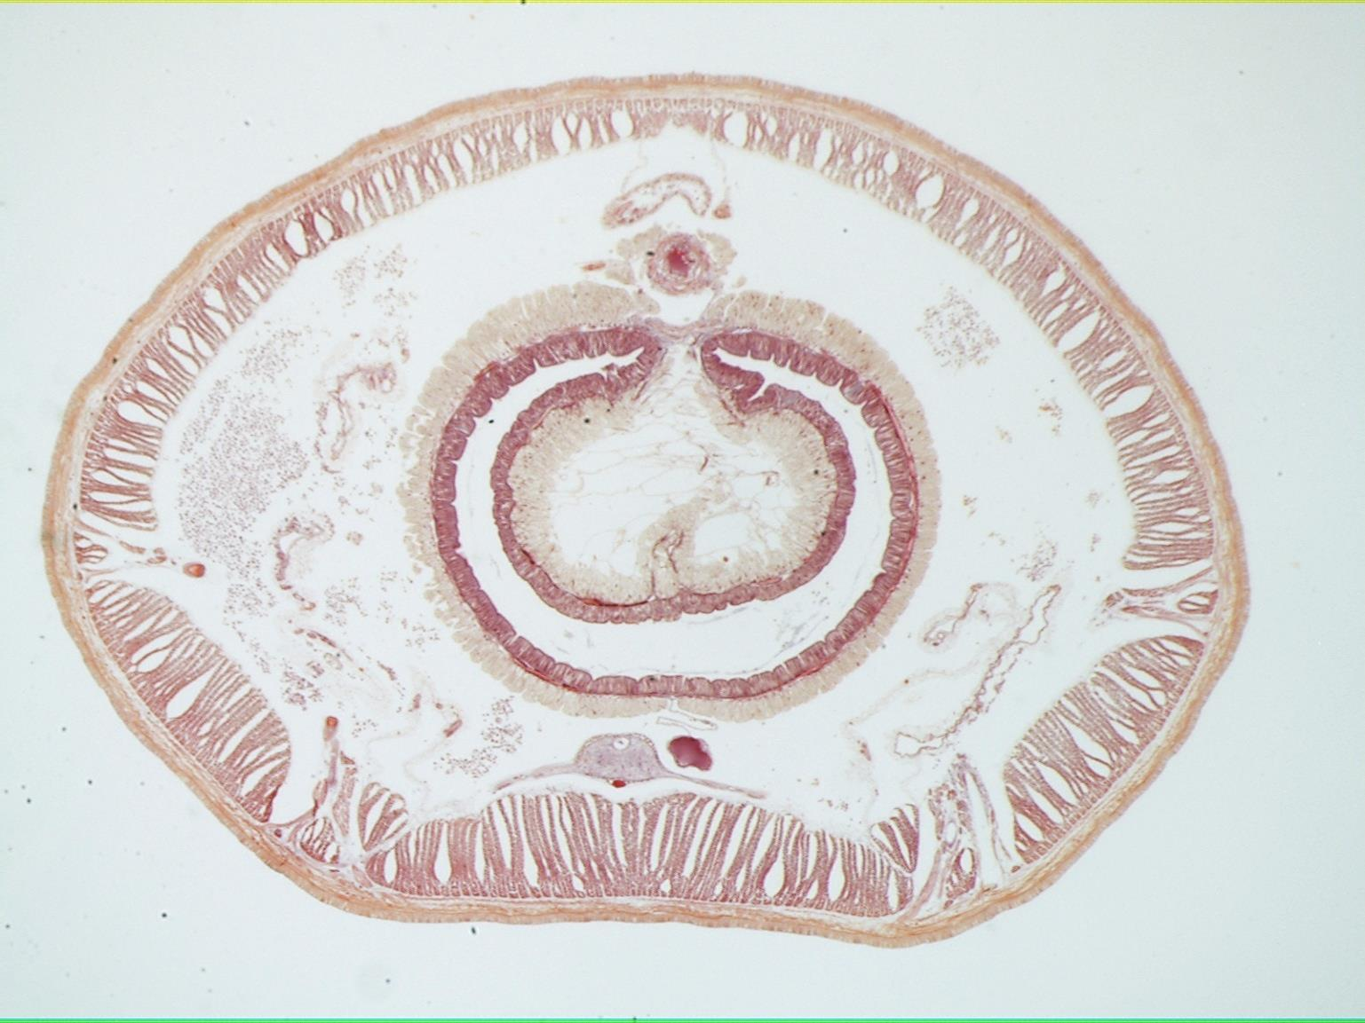
Earthworm xs

Slide 5
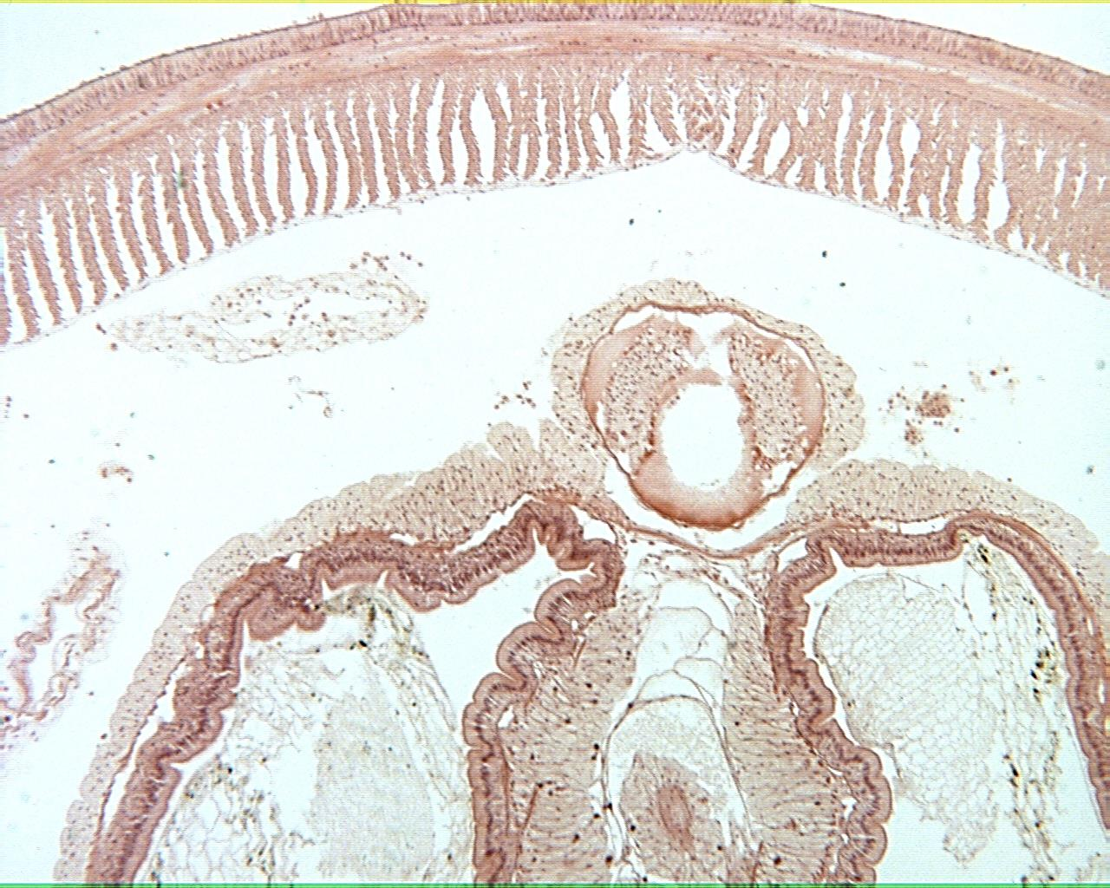
Earthworm xs 40X

Slide 6
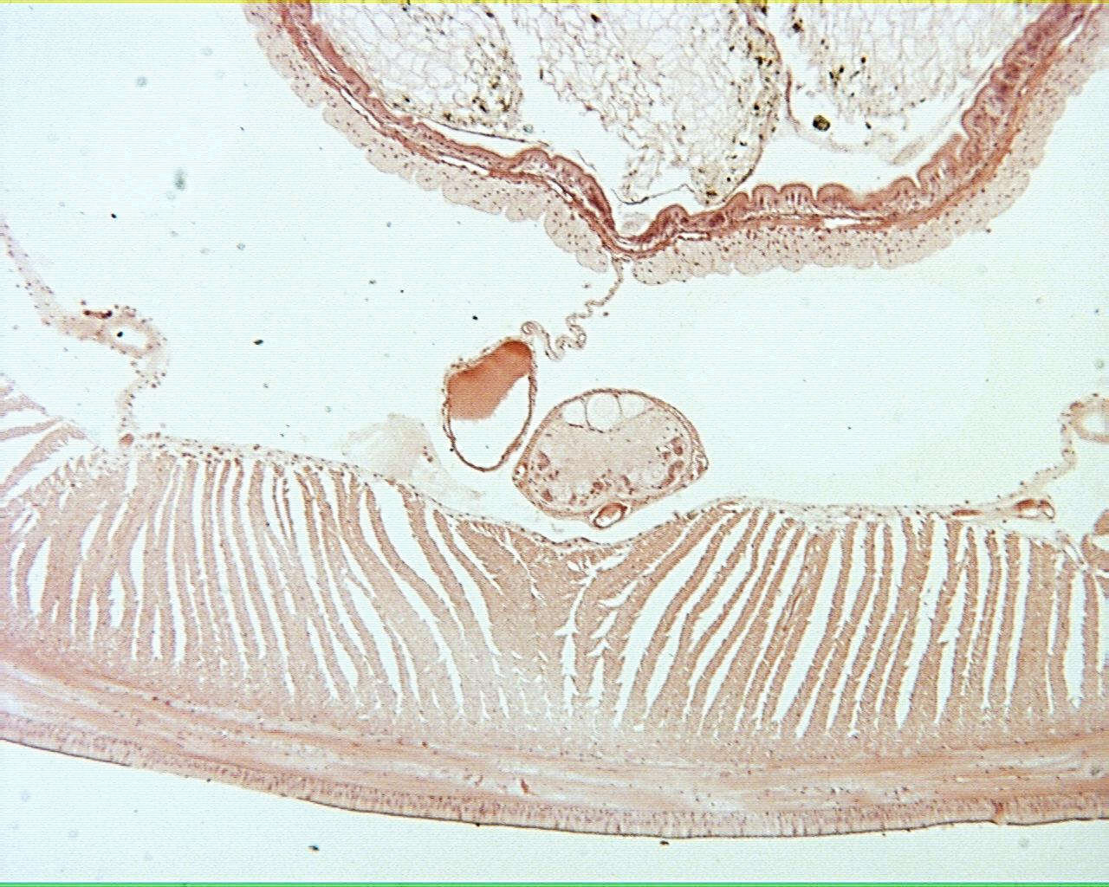
Earthworm xs 40X

Slide 7
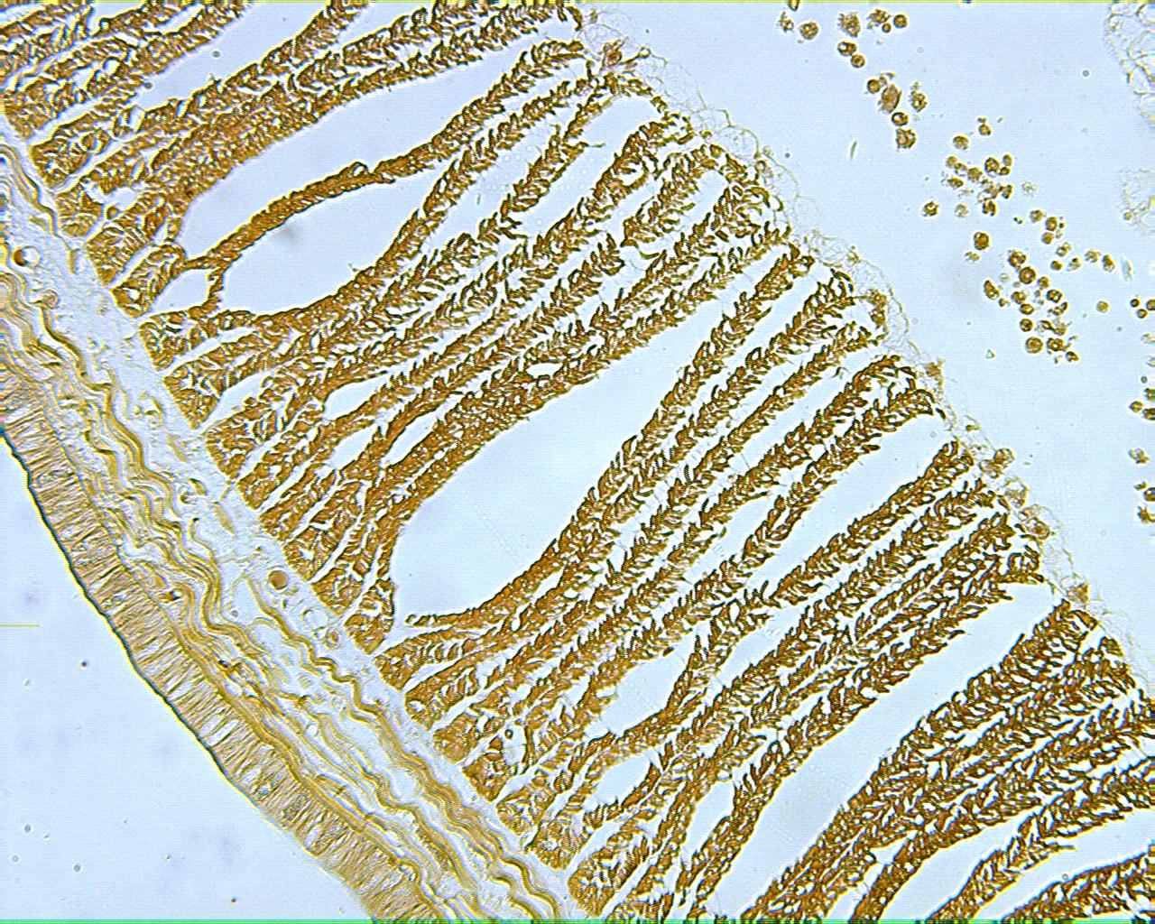
Earthworm xs 100X

Slide 8
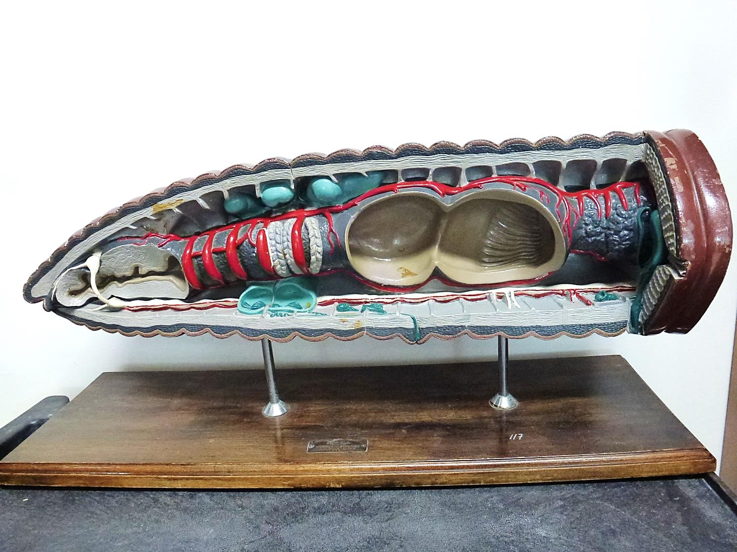
Earthworm Model

